Slide 1
Traversability and Mapping of Obstacles in Uneven Terrain Based on a Robot’s Design
Bachelor Thesis by Max-Ole von Waldow
Supervised by Dr. Ngoc Thinh Nguyen and Prof. Dr. Georg Schildbach
Notes:
Welcome to colloquium
Title of my Bachelor thesis is …

Slide 2
Table of Contents
Motivation and Background
Contributions
Terrain Features and Traversability
Implementation Approaches
Evaluation and Comparisons
Conclusions and Future Work
Notes:
Start out with …
Go into …
Look at …
Talk about …
Cover …
discuss …
Evaluate & Compare
Finish with …

Slide 3
Motivation
Motivation and Background
Use cases:
Agriculture (KRIBL project)
Extraterrestrial exploration
Rescue robotics
Goals
Determine traversability tailored to design of the robot
Map obstacles for navigation software
Modularity
Expand projects to rough terrain
Notes:
Use-cases with Need for navigation in uneven terrain
Ongoing KRIBL project involving ROB institute: move through crop fields
Space: not structured environment to drive in. Rover on mars stuck → expensive mission fail, nobody there to physically fix situation
Rescue robotics: man-made structures destroyed after disaster. Navigate in ruins to aid victims & emergency forces
→ In common: robotic platform need to traverse unstructured environments safely
Determine traversability in uneven terrain → tailored to specific robot -> bc robot specification affects traversability
Save Untraversable regions as obstacles in map → 3rd party software
Embrace modularity. Want to make our method easy integrate.
Expand … work in …

Slide 4
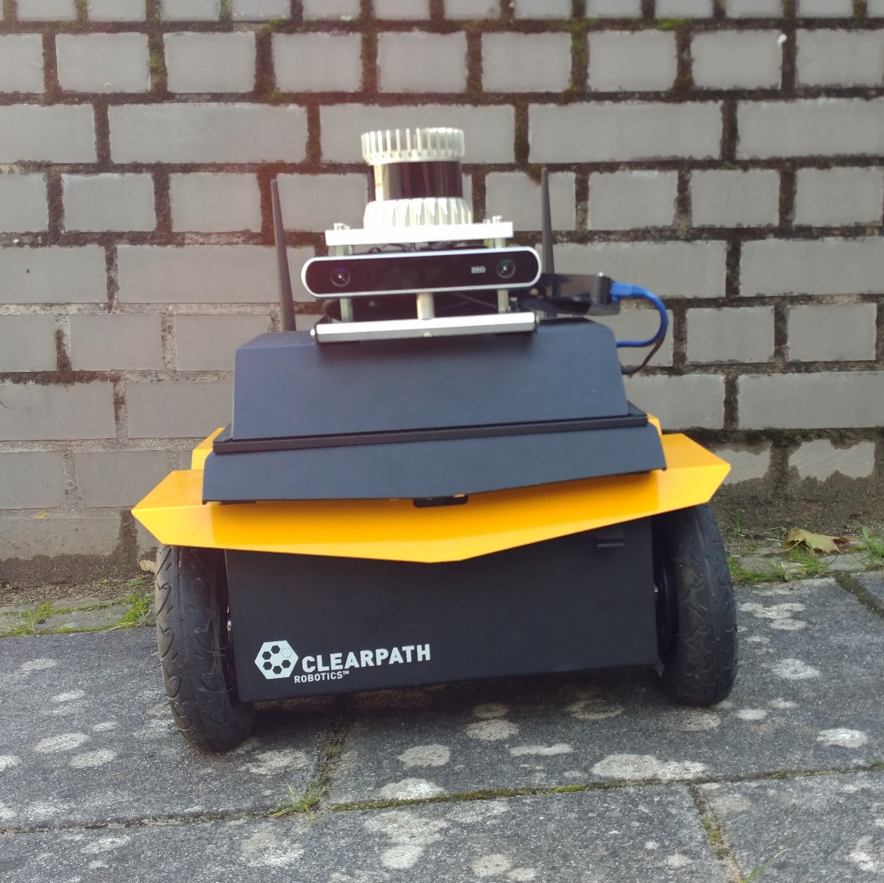
Background
Motivation and Background
Jackal [Chen, 2017]
ZED Camera [Ortiz, 2018]
[Ortiz, 2018]
Ortiz, L. E., Cabrera, V. E., and Goncalves, L. M. Depth data error modeling of the ZED 3D vision sensor from stereolabs. In: ELCVIA: electronic letters on computer vision and image analysis 17(1):1–15, 2018.
[Chen, 2017]
Chen, Y. F., Everett, M., Liu, M., and How, J. P. Socially aware motion planning with deep reinforcement learning. In: 2017 IEEE/RSJ International Conference on Intelligent Robots and Systems (IROS). IEEE. 2017, pp. 1343–1350.
Notes:
Jackal:
Why: -> rugged, mobile platform → optimal
ZED Stereo camera:
Why: -> already equipped, detailed point cloud(for small edges), (visual odometry)

Slide 5
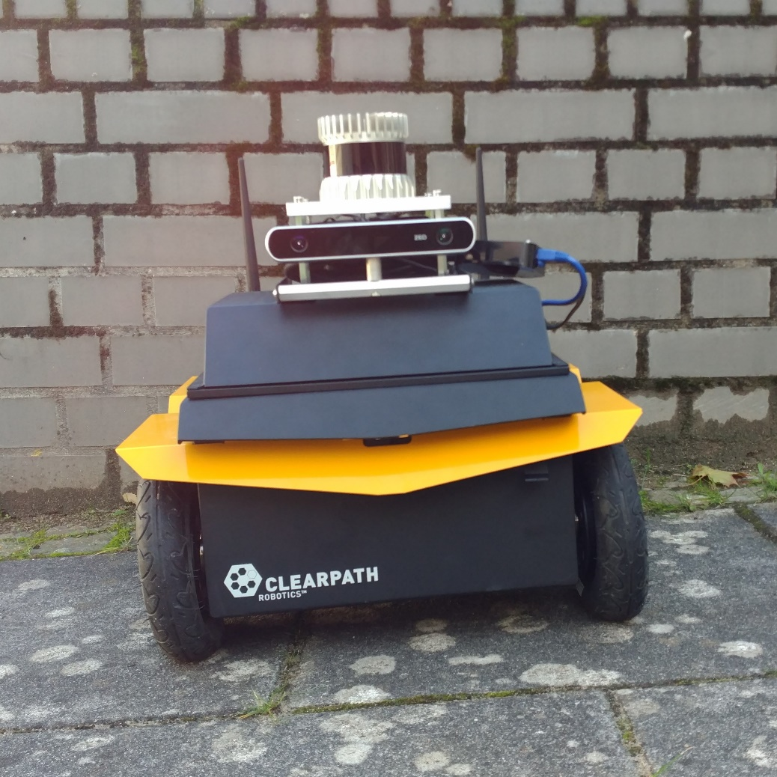
Background
Motivation and Background
Jackal [Chen, 2017]
ZED Camera [Ortiz, 2018]
ROS [Quigley, 2009]
[Quigley, 2009]
Quigley, M., Conley, K., Gerkey, B., Faust, J., Foote, T., Leibs, J., Wheeler, R., Ng, A. Y., et al. ROS: an open-source Robot Operating System. In: ICRA workshop on open source software. Vol. 3. 3.2. Kobe, Japan. 2009, p. 5.
Notes:
Why: -> modular, widespread, existing 3rd party packages

Slide 6
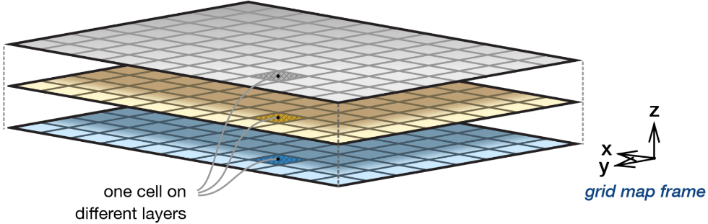
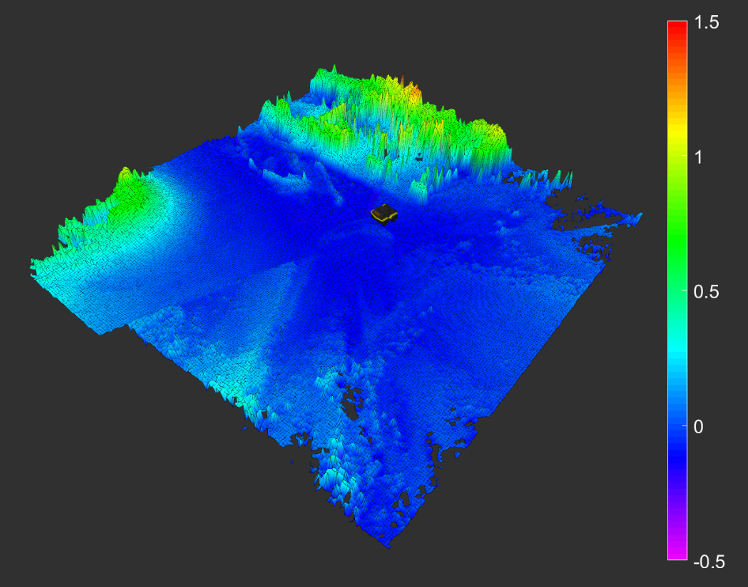
Background
Motivation and Background
Jackal [Chen, 2017]
ZED Camera [Ortiz, 2018]
ROS [Quigley, 2009]
Elevation Mapping
[Fankhauser, 2018]
Grid map [Fankhauser, 2016]
Filter chain
Image from [Fankhauser, 2016]
meters
[Fankhauser, 2016]
Fankhauser, P. and Hutter, M. A Universal Grid Map Library: Implementation and Use Case for Rough Terrain Navigation. In: Robot Operating System (ROS) – The Complete Reference (Volume 1). Ed. by A. Koubaa. Springer, 2016. Chap. 5.
[Fankhauser, 2018]
Fankhauser, P., Bloesch, M., and Hutter, M. Probabilistic Terrain Mapping for Mobile Robots with Uncertain Localization. In: IEEE Robotics and Automation Letters (RA-L) 3(4):3019–3026, 2018.
Notes:
Why:
-> robot-centric,
-> convenient data structure, multiple values per coordinate in the map
-> easy processing with filter chain

Slide 7
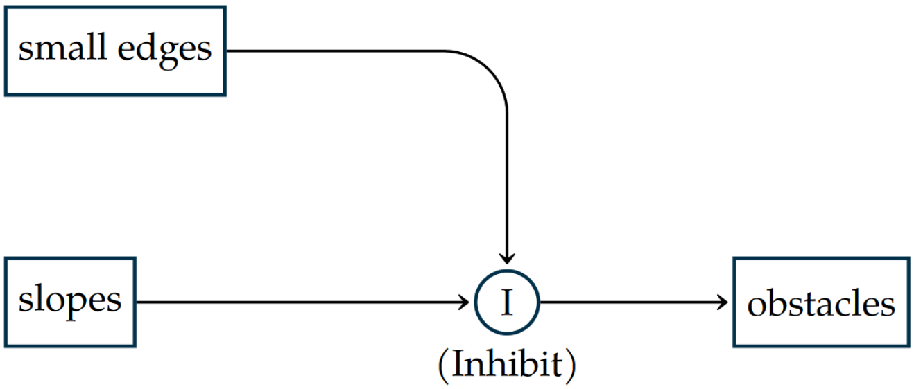
Terrain Features and Traversability
Contributions
Slopes
Tipping
Slipping
Lack of motor power
Edges
Combination:
Small edges inhibit obstacles from high slopes
Subsumption architecture [Brooks, 1991]
[Brooks, 1991]
Brooks, R. A. New approaches to robotics. In: Science 253(5025):1227–1232, 1991.
Notes:
Cannot anticipate all types of untraversable regions
Abstract feature to cover most
General properties:
- Slope (walls, hill, holes, …)
single variable: angle
failure cases: …
slope limit each → minimum
- Edges (sidewalk curb, small rock)
steep slope, consider height instead of inclination
Combine Features → Subsumption architecture
Regard Slope & Edge as behaviors; both have threshold (angle, edge height, respectively) to classify region traversable or not
- slope default
- exception: small edge inhibits region being marked as obstacle by slope behavior

Slide 8
Subsumption architecture [Brooks, 1991]
Contributions
Merged Obstacles from slope and edge behaviors | Slope: obstacle | Slope: traversable
Edge: obstacle | Obstacle | Not Possible
Edge: traversable | No Obstacle | No Obstacle
[Brooks, 1991]
Brooks, R. A. New approaches to robotics. In: Science 253(5025):1227–1232, 1991.
Notes:
Slope traversable → edge behavior not active. No steep slope means no edge
Both Obstacle → Both agree; Edge does not inhibit slope
Only slope obstacle → slope has false positive; Edge inhibits slope obstacle

Slide 9
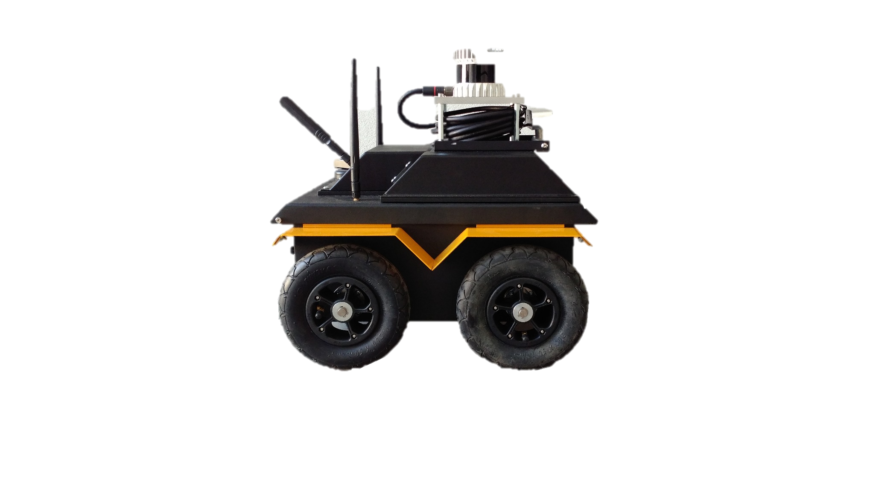
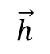
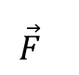
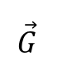
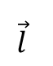
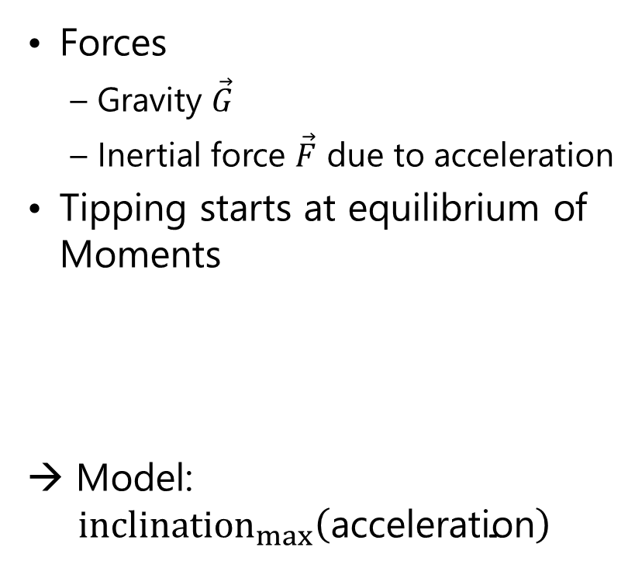
Slopes - Tipping
Contributions
Forces
Gravity $\vec{G}$
Inertial force $\vec{F}$ due to acceleration
Tipping starts at equilibrium of Moments
→ Model: ${ inclination}_{max}\left(\text{acceleration}\right)$
$$\vec{F}$$
$$\vec{h}$$
$$\vec{l}$$
$$\vec{G}$$
Notes:
Red: CoG
Green: Critical tipping point, Hind contact points with ground
Static case (no accel): Gravity, slope angle effects len L, (lever arm of Force around tipping point)
Dynamic: Inertial force, tips robot accelerating uphill
( simplified, Forces act at contact points with ground. Mass resists acceleration → called inertia )
Both forces create moments around point marked green. Equilibrium

Slide 10
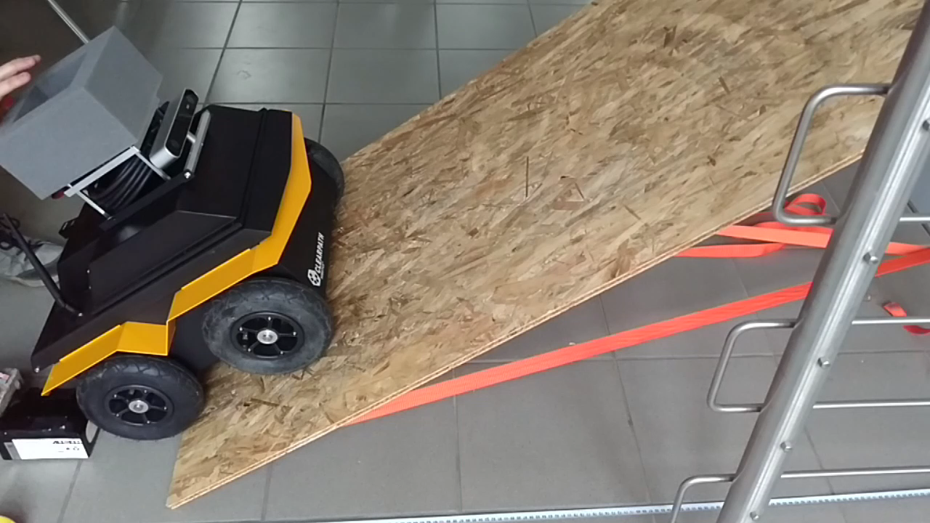
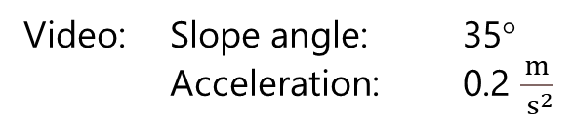
Contributions
Video: Slope angle: 35°
Acceleration: 0.2 $\frac{m}{{ s}^{2}}$
→ Success
Notes:
Experiment to Validate
Ramp leans on and is strapped to different levels of staircase railing

Slide 11
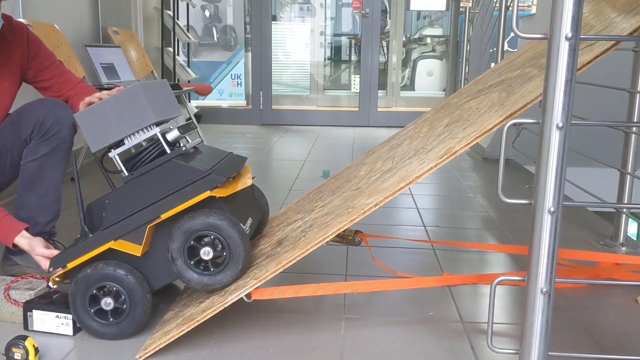

Contributions
Video: Slope angle: 35°
Acceleration: 1.0 $\frac{m}{{ s}^{2}}$
→ Failure
Notes:
( Limit at deg : 0.9 m/s^2 )
( Slope limit at max accel (m/s^2): … deg )

Slide 12
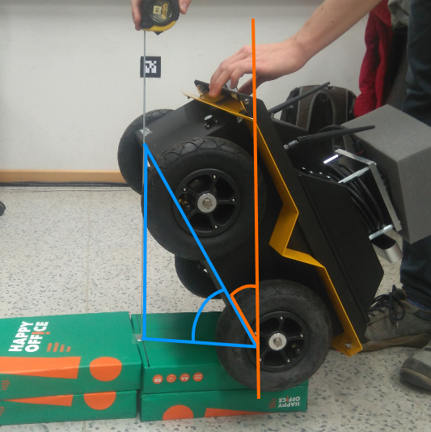
Slopes - Tipping
Contributions
Find Center of Gravity (CoG)
Balance Jackal above edge
CoG must lie above edge in plane (orange)
Define plane through angle with law of cosines (blue)
Notes:
CoG must lie above edge => orange

Slide 13
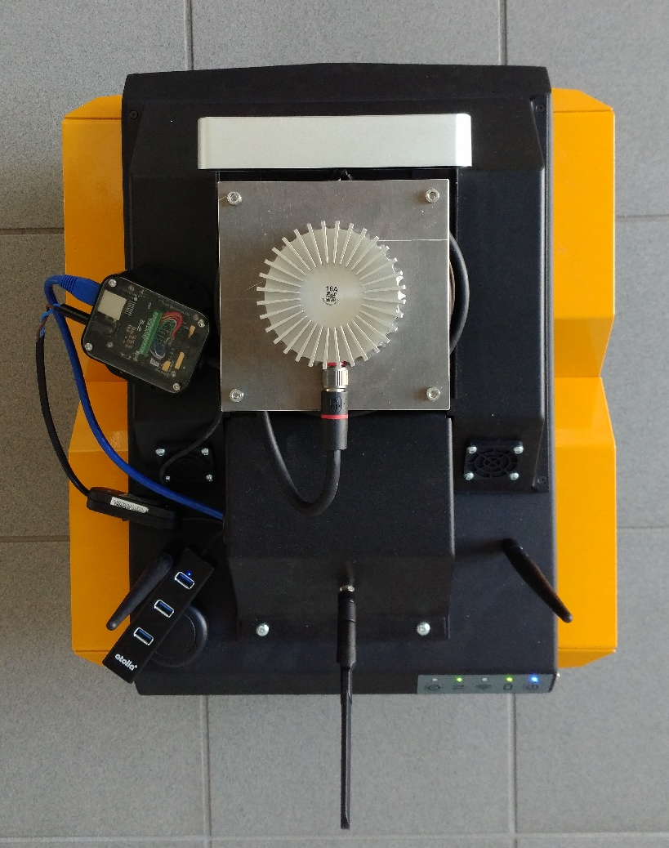
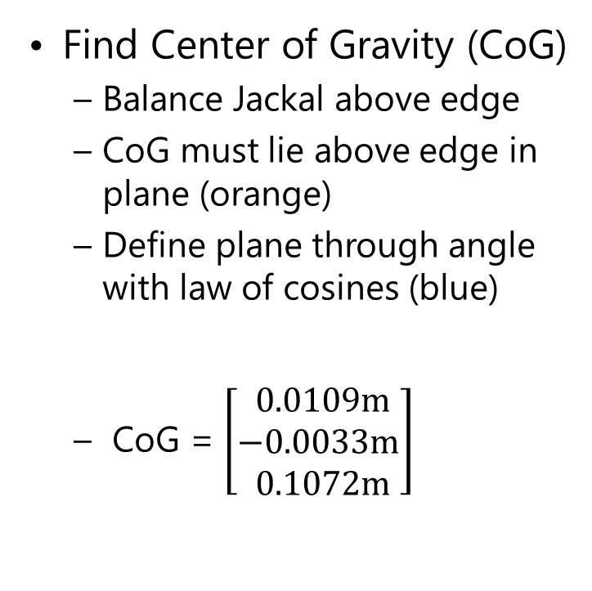
Slopes - Tipping
Contributions
Find Center of Gravity (CoG)
Balance Jackal above edge
CoG must lie above edge in plane (orange)
Define plane through angle with law of cosines (blue)
CoG = $\left[\begin{matrix} 0.0109m \\ −0.0033m \\ 0.1072m\end{matrix}\right]$
x
CoG
y
Notes:
Result:
Frame base_link, geometric center
Top view, position exaggerated for visualization

Slide 14
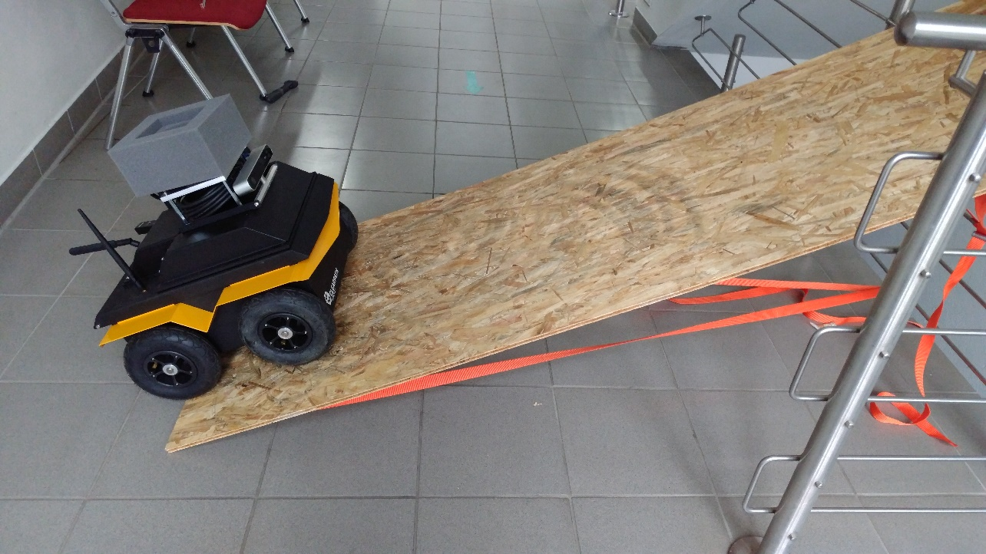
Slopes - Slipping
Contributions
Skid steering increases slippage
Experiment to find inclination limit with tolerable slippage
Notes:
Jackal differentially driven, skid steering
Expect: higher slope <-> higher slippage

Slide 15
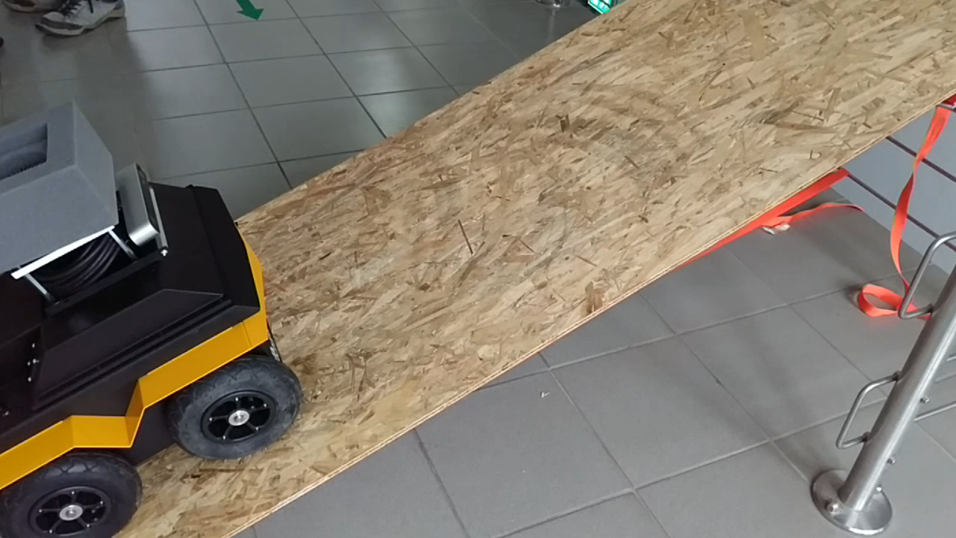
Contributions
Video: Ramp inclination: 25°
Pre-programmed motion
→ No correlation found
between angle and slippage
Notes:
No correlation …
→ won’t take slippage into account for Jackal

Slide 16
Slopes - Lack of motor power
Contributions
Wheel torque to overcome gravity
Calculate wheel torque from power etc.
Notes:
Robot needs enough wheel torque to overcome gravity.
Motors need to be powerful to move the robot’s own weight.
T = r*P/v
( 500 Watt drive power ) which is large enough to control Jackal on any inclination.

Slide 17
Slopes - Lack of motor power
Contributions
Wheel torque to overcome gravity
Calculate wheel torque from power and velocity
Torque
Driven Wheel
Radius
Force
Notes:
Robot needs enough wheel torque to overcome gravity.
Motors need to be powerful to move the robot’s own weight.
( 500 Watt drive power ) which is large enough to control Jackal on any inclination.
TODO fig?

Slide 18
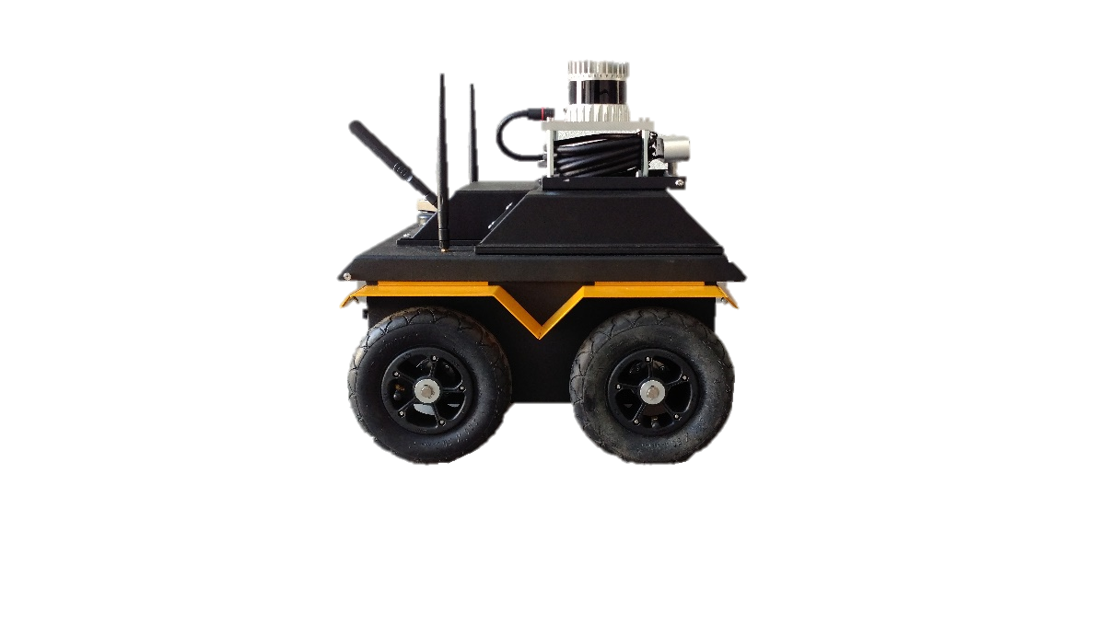
Edges
Contributions
Experiment with variables:
Edge height
Approach angle
Driving direction
Notes:
Vary: Edge height, Approach angle, (driving direction)
friction, wheel type of Jackal

Slide 19
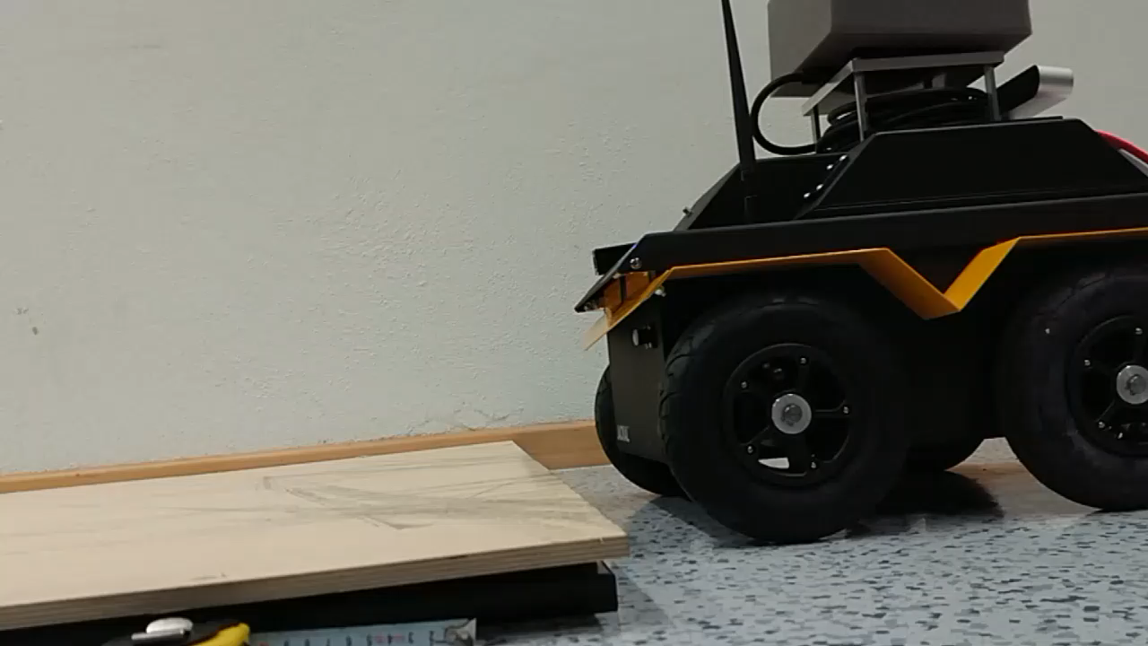
Contributions
Video: Edge height: 5 cm
Approach angle: 0°
Driving direction: Backwards
→ Success

Slide 20
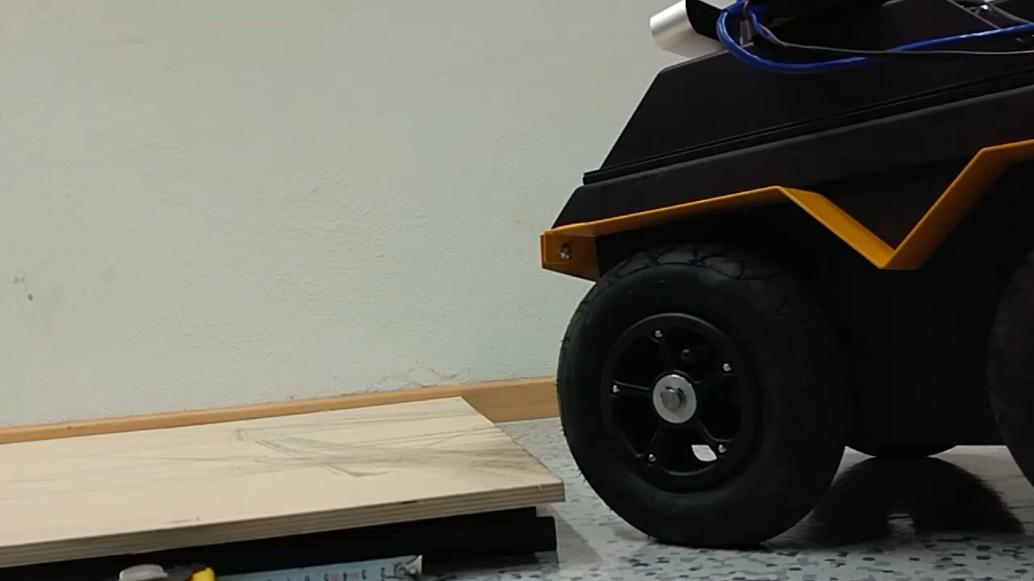
Contributions
Video: Edge height: 5 cm
Approach angle: 45°
Driving direction: Forwards
→ Failure
Notes:
Approach angle has a major impact of what edge height can be traversed.
( Edge limit: 3.0 cm (regardless of approach angle & driving direction) )

Slide 21
Edges
Contributions
Experiment
Ground clearance

Slide 22

Edges
Contributions
Experiment
Ground clearance
Footprint
Notes:
Footprint: 37.559 cm square

Slide 23
Implementation Approachs – Conservative Method
Contributions
Assume worst control
Output conservative obstacles
Height
Map
Conservative Obstacles
Control
Output
Elevation mapping
Filter Chain
Control Software
Drive
Notes:
configure filter chain in Compile Step, evaluate models
Control software includes path planner and controller to move robot along path
No feedback
can’t know how robot will move
Problem bc: traversability of slope depends on accel & edge height that can be overcome depends on approach angle
[CLICK] Can’t know variables, Assume worst control
[CLICK] conservative obstacles
Restrictive map

Slide 24
Implementation Approachs – Control Limiting Method
Contributions
Assume best control
Output control limits and fundamental obstacles
Control
Limits
Control
Output
Control limiting
Limited
Control
Output
Height
Map
Fundamental Obstacles
Elevation mapping
Filter Chain
Control Software
Drive
Notes:
Compile step: configure filter chain
Influence control limits
→ [CLICK] assume best control
→ [CLICK] Fundamental obstacles

Slide 25
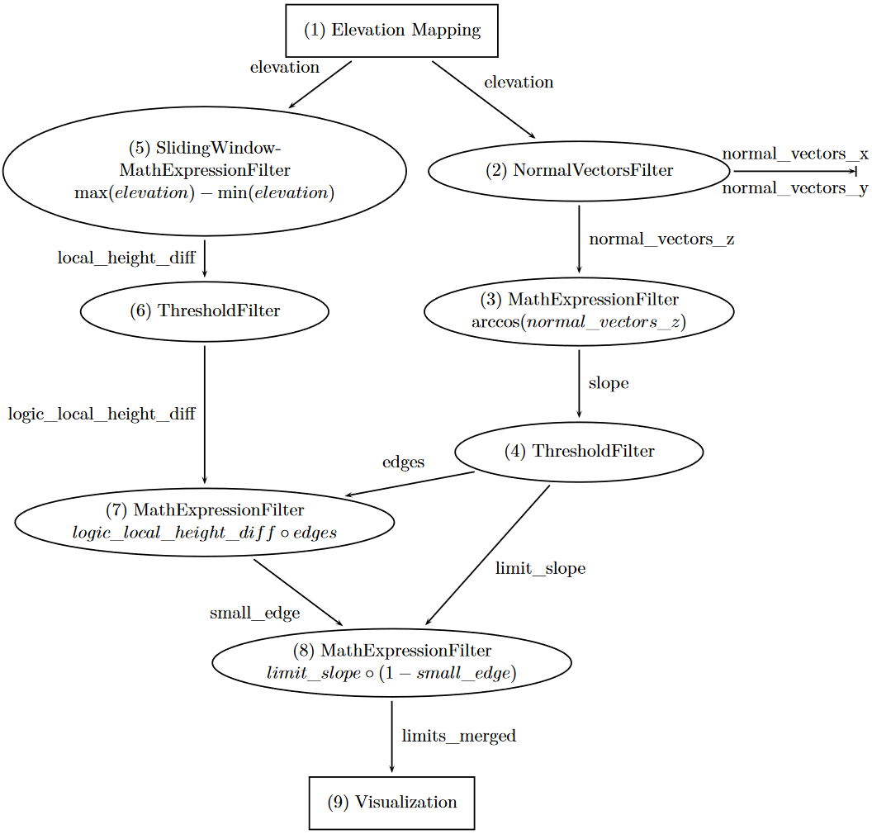
Filter Chain
Edge
Behavior
Contributions
Slope
Behavior
Combination
Notes:
Elevation Mapping Package
Slope behavior
Edge behavior
Combination with Subsumption arbiter
Visualization, convert grid map layer to occupancy grid for which more tools exist

Slide 26
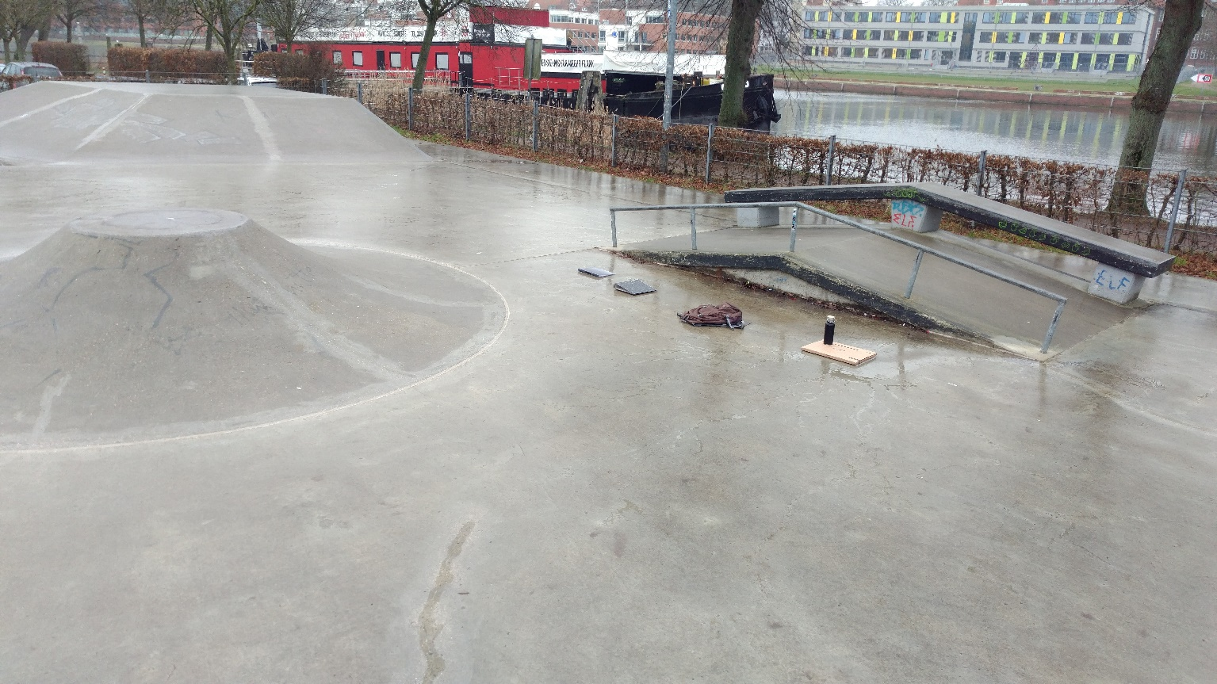
Evaluation and Comparisons
Evaluation and Comparisons
Skate park
Notes:
Why?: All Obstacle
(left) island; (back) double ramp; (between) our obstacles; types available

Slide 27
Evaluation and Comparisons
Evaluation and Comparisons
Skate park
Software
move_base controller
Offline B-Spline path planner [Nguyen, 2021]
gmapping [Grisetti, 2007]
meters
[Nguyen, 2021]
Nguyen, N. T., Schilling, L., Angern, M. S., Hamann, H., Ernst, F., and Schildbach, G. B-spline path planner for safe navigation of mobile robots. In: 2021 IEEE/RSJ International Conference on Intelligent Robots and Systems (IROS). IEEE. 2021, pp. 339–345.
[Grisetti, 2007]
Grisetti, G., Stachniss, C., and Burgard, W. Improved techniques for grid mapping with rao-blackwellized particle filters. In: IEEE transactions on Robotics 23(1):34–46, 2007.
Notes:
Image our elevation mapping:
(left) island; (back) double ramp; (between) our obstacles; (front) sensor errors
Move base: Part of ROS navigation stack
B-Spline path planner: Offline, because no ROS integration
Gmapping: Standard, commonly used SLAM method for 2D cases

Slide 28
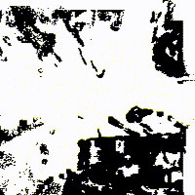
Evaluation and Comparisons
Evaluation and Comparisons
Fundamental and conservative obstacles (overlayed)
Fundamental obstacles are less exaggerated
Notes:
Island top right, where difference is especially visible

Slide 29
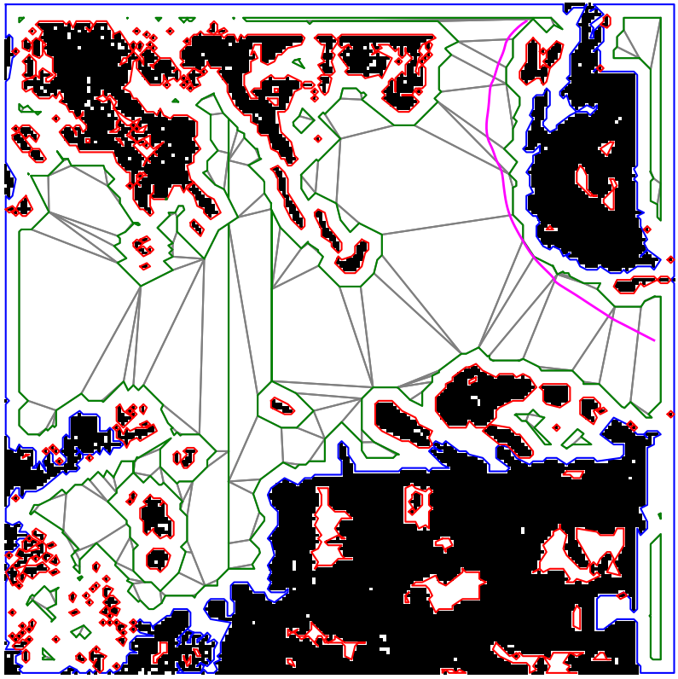
Evaluation and Comparisons
Evaluation and Comparisons
Fundamental and conservative obstacles (overlayed)
Fundamental obstacles are less exaggerated
Integration with B-Spline path planner [Nguyen, 2021]
B-Spline in conservative map
[Nguyen, 2021]
Nguyen, N. T., Schilling, L., Angern, M. S., Hamann, H., Ernst, F., and Schildbach, G. B-spline path planner for safe navigation of mobile robots. In: 2021 IEEE/RSJ International Conference on Intelligent Robots and Systems (IROS). IEEE. 2021, pp. 339–345.
Notes:
Map divided into polytopes
Asked find path around island

Slide 30
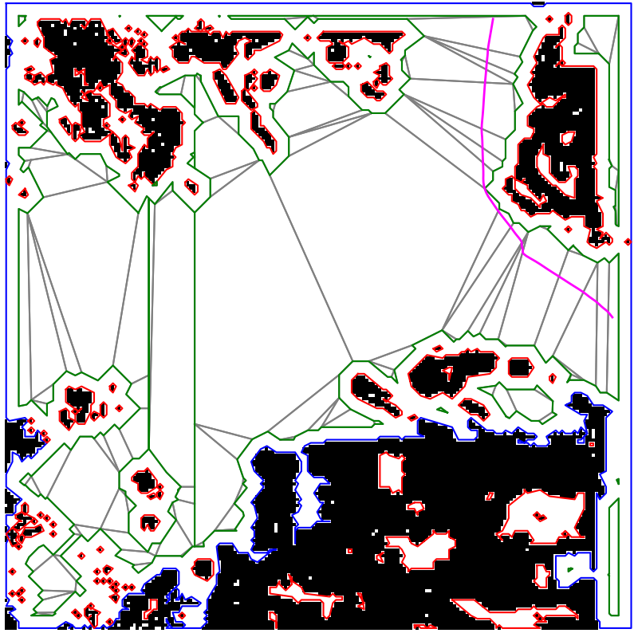
Evaluation and Comparisons
Evaluation and Comparisons
Fundamental and conservative obstacles (overlayed)
Fundamental obstacles are less exaggerated
Integration with B-Spline path planner [Nguyen, 2021]
B-Spline in non-conservative map
[Nguyen, 2021]
Nguyen, N. T., Schilling, L., Angern, M. S., Hamann, H., Ernst, F., and Schildbach, G. B-spline path planner for safe navigation of mobile robots. In: 2021 IEEE/RSJ International Conference on Intelligent Robots and Systems (IROS). IEEE. 2021, pp. 339–345.

Slide 31
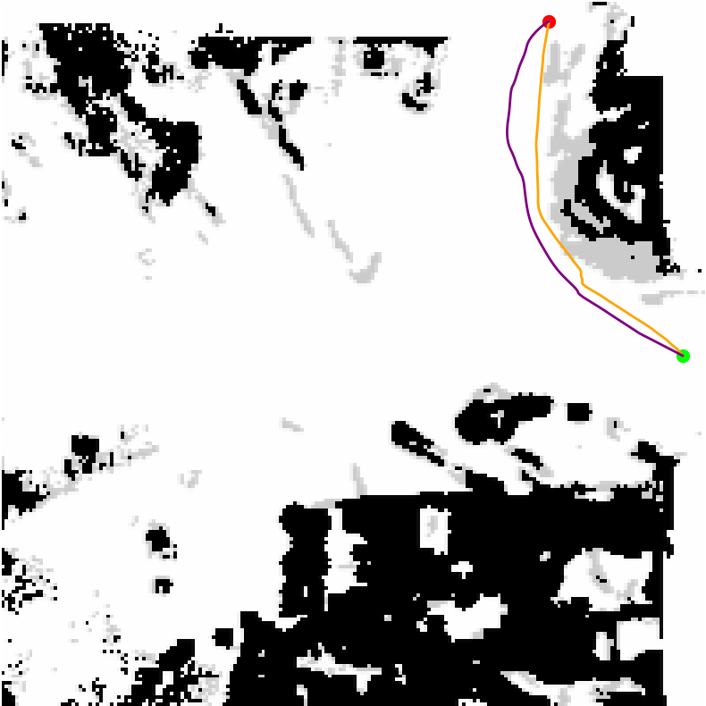
Evaluation and Comparisons
Evaluation and Comparisons
conservative method
control limit method
Fundamental and conservative obstacles (overlayed)
Fundamental obstacles are less exaggerated
Integration with B-Spline path planner [Nguyen, 2021]
Orange path is shorter and subject to control limits
[Nguyen, 2021]
Nguyen, N. T., Schilling, L., Angern, M. S., Hamann, H., Ernst, F., and Schildbach, G. B-spline path planner for safe navigation of mobile robots. In: 2021 IEEE/RSJ International Conference on Intelligent Robots and Systems (IROS). IEEE. 2021, pp. 339–345.

Slide 32
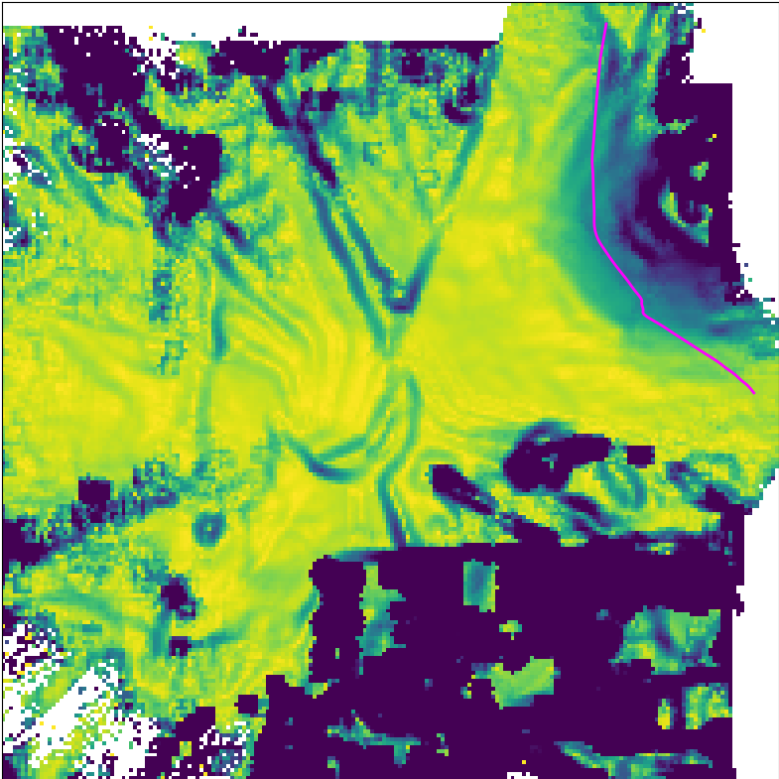
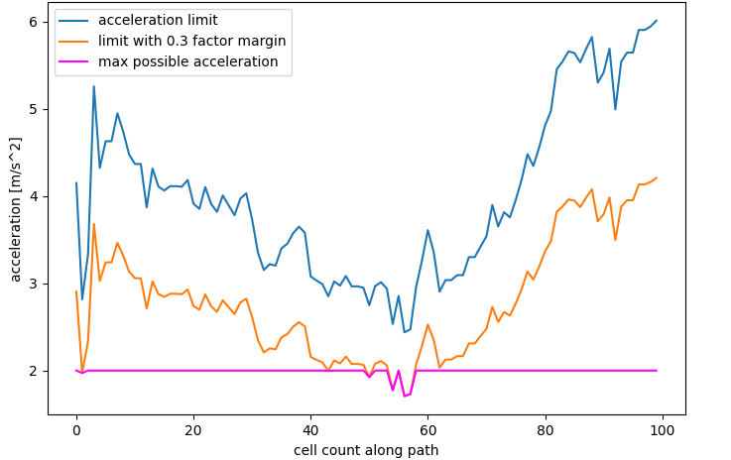
Evaluation and Comparisons
Evaluation and Comparisons
Control limits on path
Safety margin

Slide 33
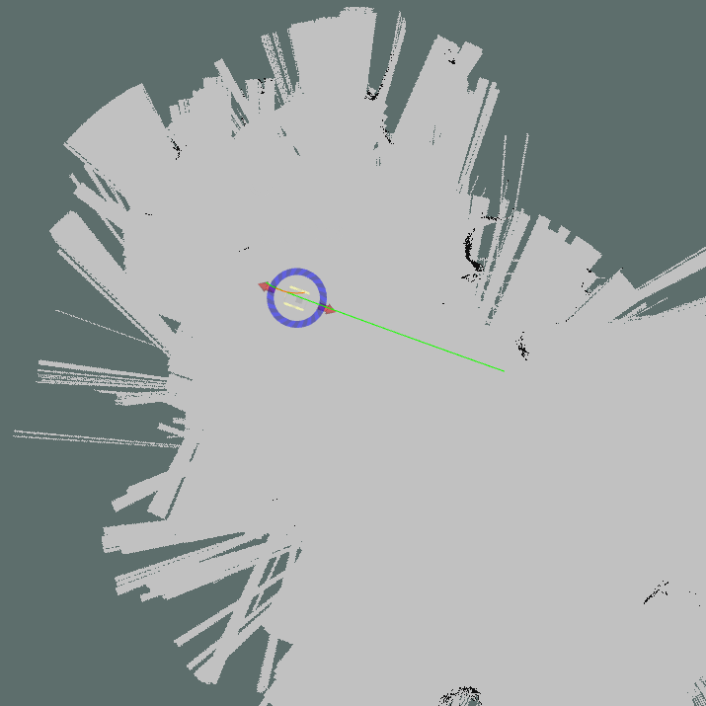
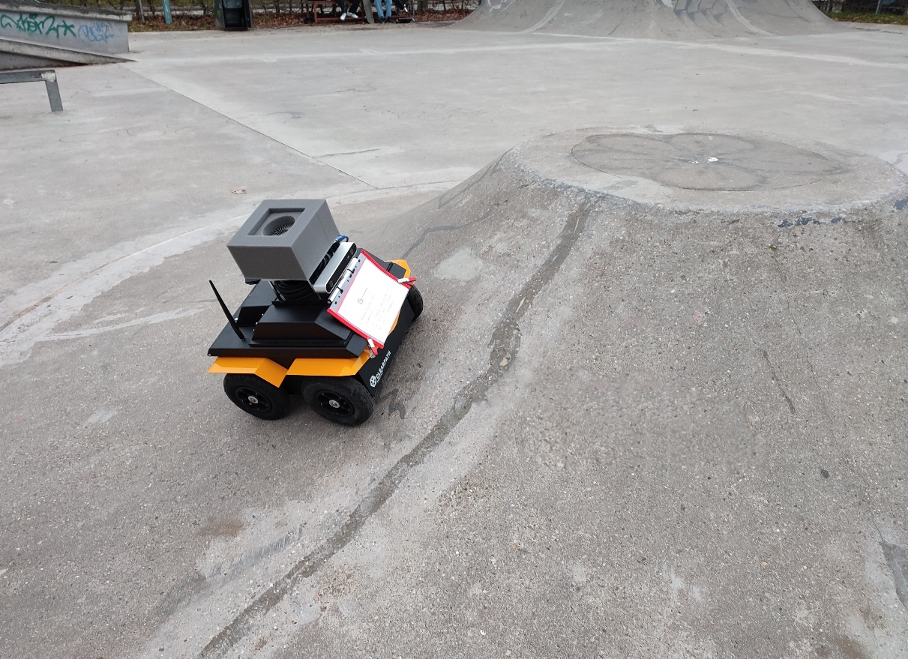
Comparison with gmapping [Grisetti, 2007]
Evaluation and Comparisons
[Grisetti, 2007]
Grisetti, G., Stachniss, C., and Burgard, W. Improved techniques for grid mapping with rao-blackwellized particle filters. In: IEEE transactions on Robotics 23(1):34–46, 2007.
Notes:
Ask move_base to find Similar Path around island in this map
Island not well represented in map → path planner chooses straight line
Leads Jackal on Dangerous path, not suited for uneven environments

Slide 34
Comparison with gmapping [Grisetti, 2005 and 2007]
Evaluation and Comparisons
No traversability consideration
Issue with 2D sensor information

Slide 35
Conclusions
Conclusions and Future Work
Able to determine traversability
Outperforms gmapping in uneven terrain
Modular
Pro: Easy to integrate
Contra: Future trajectory unknown; Assumptions needed
(mitigated by control limiting approach)
Future Work
Reduce assumptions
Consider robot orientation
Notes:
Traversability in rough terrain
Contra partially overcome with control limiting approach:
No more assumptions about Acceleration and velocity.
But: Still worst case for orientation (edge approach angle; tipping direction)

Slide 36

Future Work
Conclusions and Future Work
Reduce assumptions about robot movement
Consider robot orientation
3D grid graph
Slippage
orientation
y
x

Slide 37
Thank you for your attention! Ready for questions
References:
[Chen, 2017] | Chen, Y. F., Everett, M., Liu, M., and How, J. P. Socially aware motion planning with deep reinforcement learning. In: 2017 IEEE/RSJ International Conference on Intelligent Robots and Systems (IROS). IEEE. 2017, pp. 1343–1350.
[Ortiz, 2018] | Ortiz, L. E., Cabrera, V. E., and Goncalves, L. M. Depth data error modeling of the ZED 3D vision sensor from stereolabs. In: ELCVIA: electronic letters on computer vision and image analysis 17(1):1–15, 2018.
[Quigley, 2009] | Quigley, M., Conley, K., Gerkey, B., Faust, J., Foote, T., Leibs, J., Wheeler, R., Ng, A. Y., et al. ROS: an open-source Robot Operating System. In: ICRA workshop on open source software. Vol. 3. 3.2. Kobe, Japan. 2009, p. 5.
[Fankhauser, 2016] | Fankhauser, P. and Hutter, M. A Universal Grid Map Library: Implementation and Use Case for Rough Terrain Navigation. In: Robot Operating System (ROS) – The Complete Reference (Volume 1). Ed. by A. Koubaa. Springer, 2016. Chap. 5.
[Fankhauser, 2018] | Fankhauser, P., Bloesch, M., and Hutter, M. Probabilistic Terrain Mapping for Mobile Robots with Uncertain Localization. In: IEEE Robotics and Automation Letters (RA-L) 3(4):3019–3026, 2018.
[Brooks, 1991] | Brooks, R. A. New approaches to robotics. In: Science 253(5025):1227–1232, 1991.
[Nguyen, 2021] | Nguyen, N. T., Schilling, L., Angern, M. S., Hamann, H., Ernst, F., and Schildbach, G. B-spline path planner for safe navigation of mobile robots. In: 2021 IEEE/RSJ International Conference on Intelligent Robots and Systems (IROS). IEEE. 2021, pp. 339–345.
[Grisetti, 2007] | Grisetti, G., Stachniss, C., and Burgard, W. Improved techniques for grid mapping with rao-blackwellized particle filters. In: IEEE transactions on Robotics 23(1):34–46, 2007.

